Slide 1
Experiment-4

Slide 2
Use of existing images from Docker Hub

Slide 3


Prepared By
Bhuvnesh Sanathra
Semester-7

Slide 4
Use of existing images from Docker Hub

Slide 5
How to Use of existing images from Docker Hub ?
I took the example of MongoDB image from docker hub

Slide 6
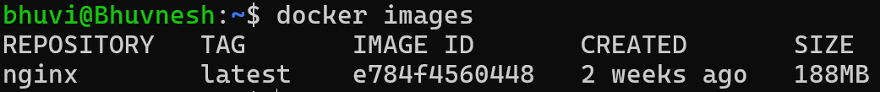
Steps to Use of existing images from Docker Hub ?
Check the docker images
# docker images

Slide 7
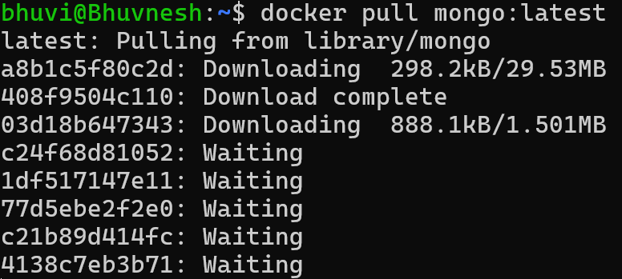
Steps to Use of existing images from Docker Hub ?
Pull the mongoDB image
# docker pull mongo:latest

Slide 8
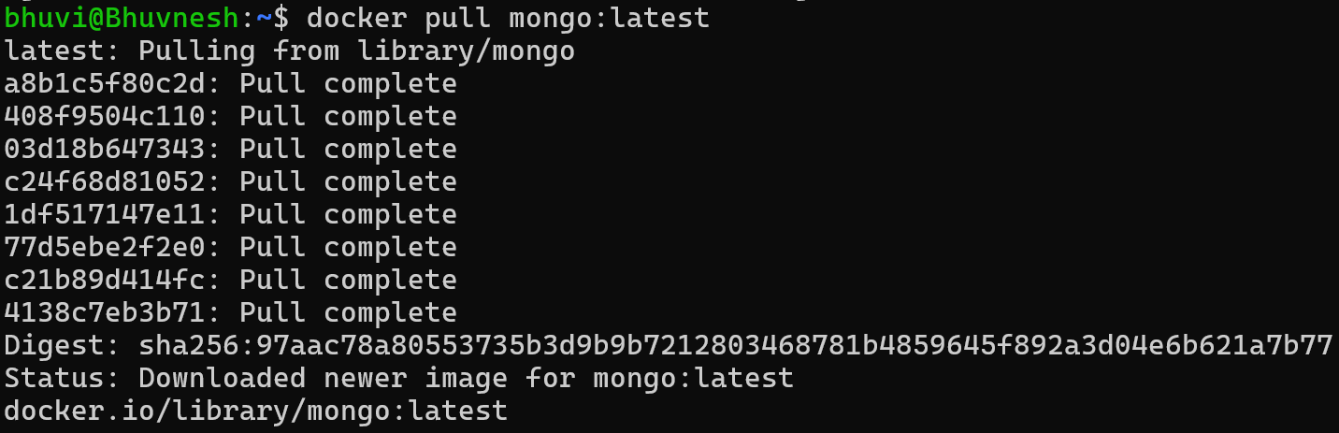
Steps to Use of existing images from Docker Hub ?

Slide 9
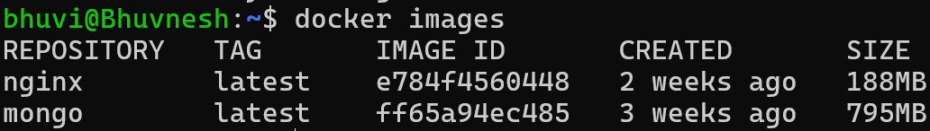
Steps to Use of existing images from Docker Hub ?
Check the docker images
# docker images

Slide 10
Steps to Use of existing images from Docker Hub ?
Make directory inside root folder
# mkdir mongoDB-bhuvi
Change directory
# cd mongoDB-bhuvi

Slide 11
Steps to Use of existing images from Docker Hub ?
Run the image inside the folder
# docker run –d –p 2717:27017 –v ~/mongoDB-bhuvi:/data/db –name bhuvimongo mongo:latest
-d -> run in background
-p -> bind the port
-v -> Volume
--name -> name of the image

Slide 12
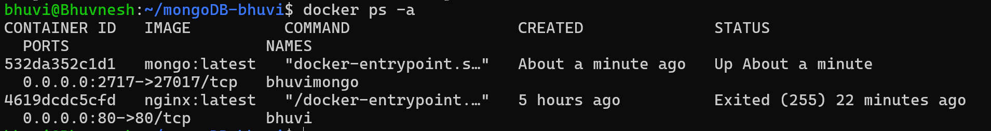
Steps to Use of existing images from Docker Hub ?
Container created check the container
# docker ps -a

Slide 13
Steps to Use of existing images from Docker Hub ?
Go inside container
# docker exec –it bhuvimongo bash

Slide 14
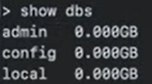
Steps to Use of existing images from Docker Hub ?
Go inside container
# docker exec –it bhuvimongo bash

Slide 15
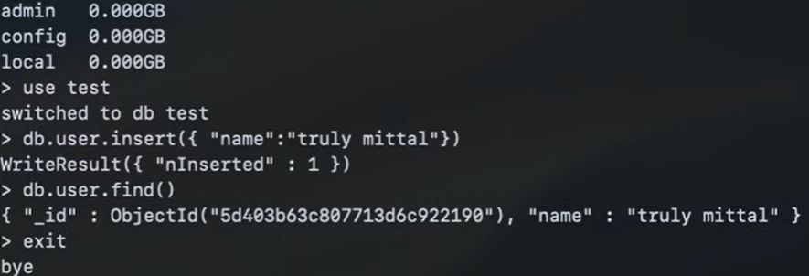
Steps to Use of existing images from Docker Hub ?

Slide 16
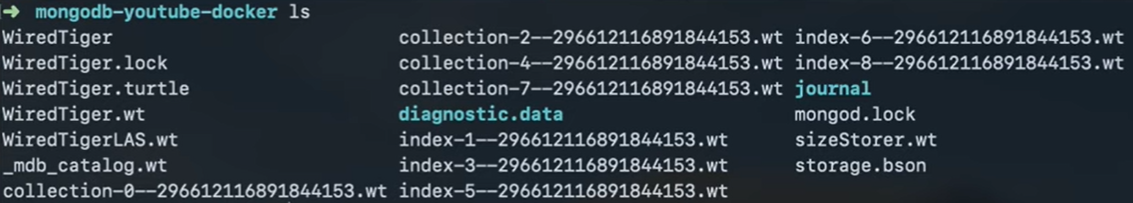
Steps to Use of existing images from Docker Hub ?

Slide 17
Thank You

